Slide 1
For Live Session Assignment (FLS)
Unit 3

Slide 2
Question 1: Quick Quiz Questions

Slide 3
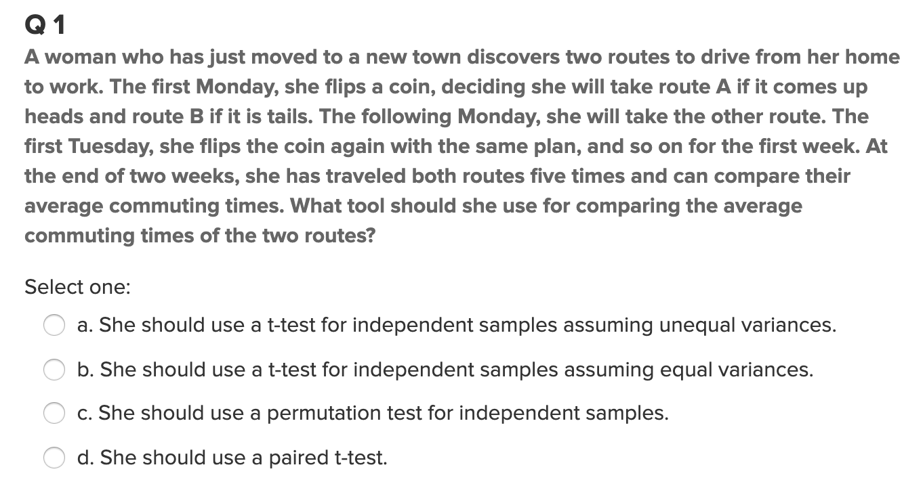
Question 1

Slide 4
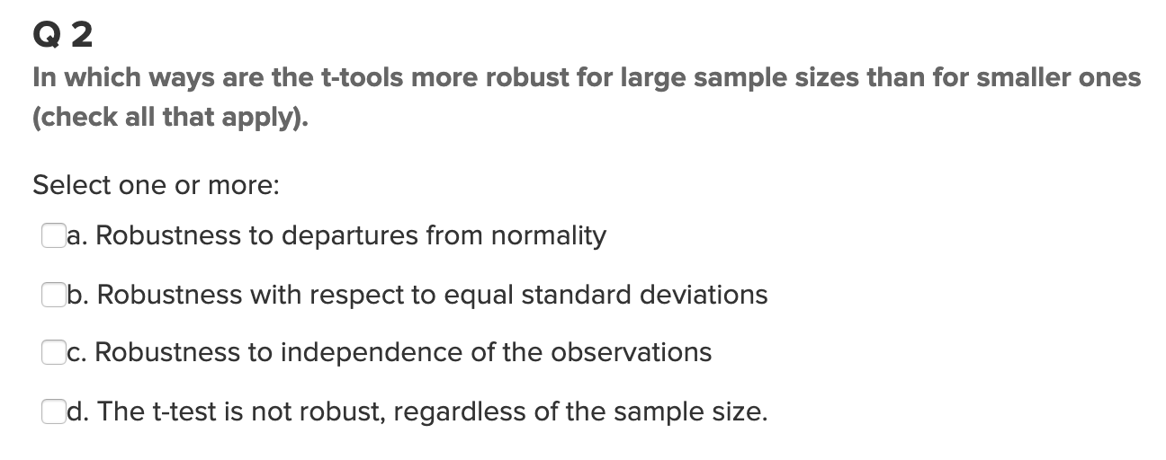
Question 2

Slide 5
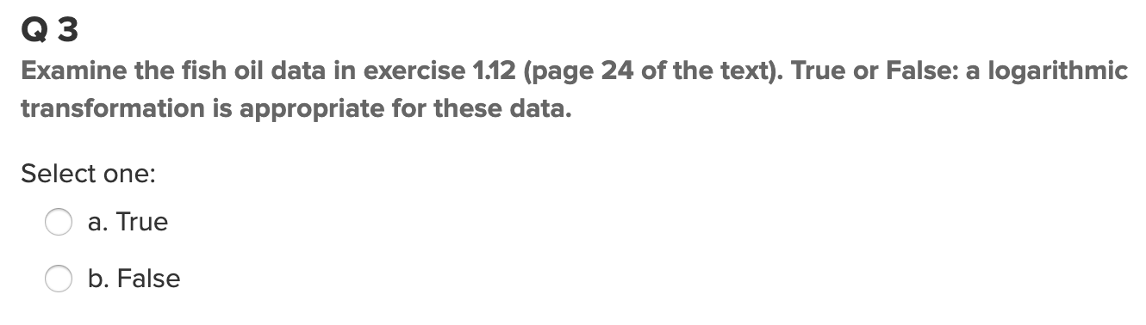
Question 3

Slide 6
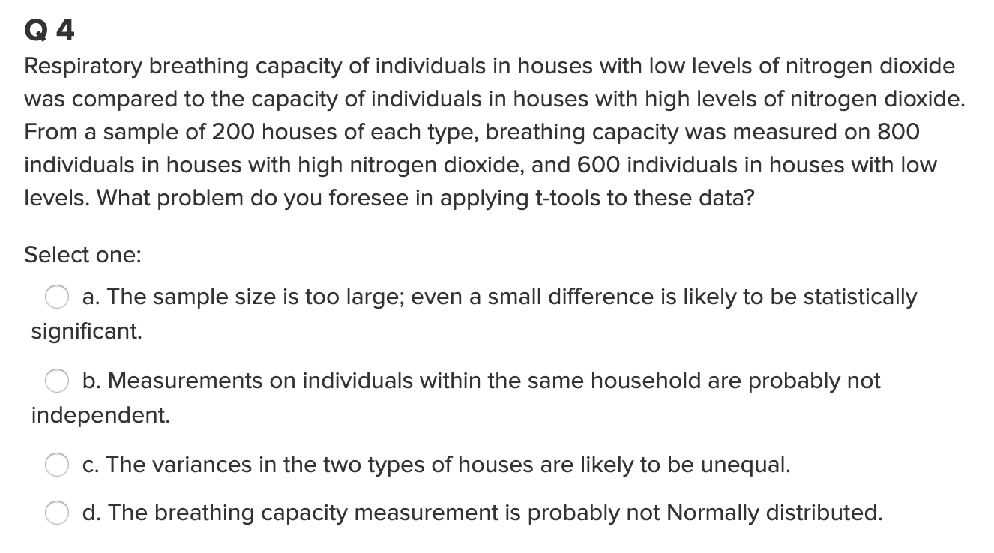
Question 4

Slide 7
End Question 1: Quick Quiz Questions

Slide 8

Question 2 ($≤2$ hours)

Slide 9
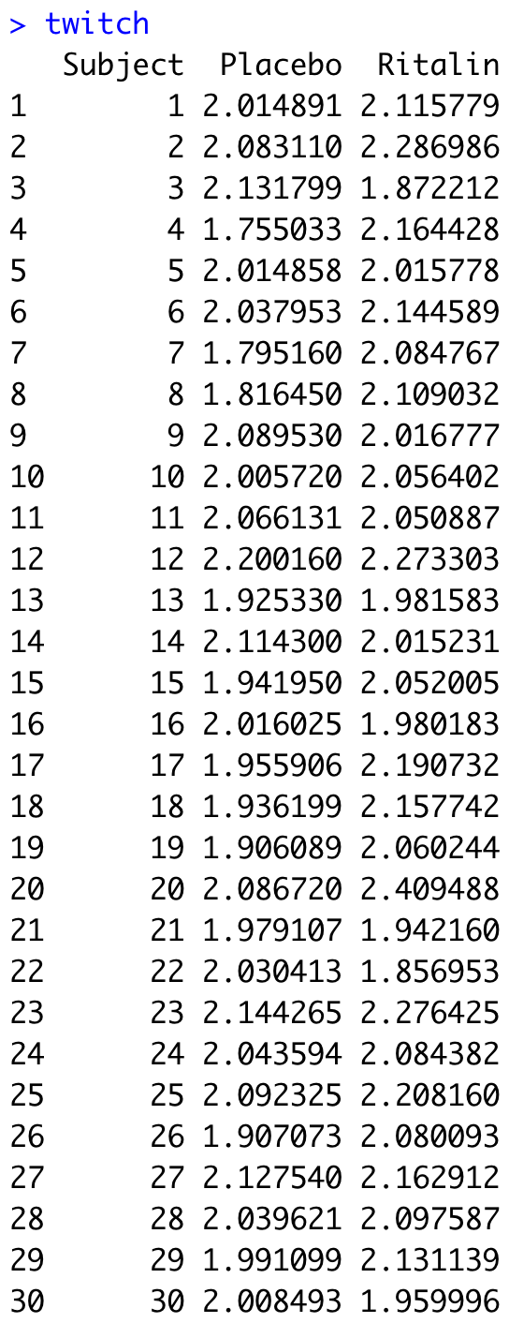
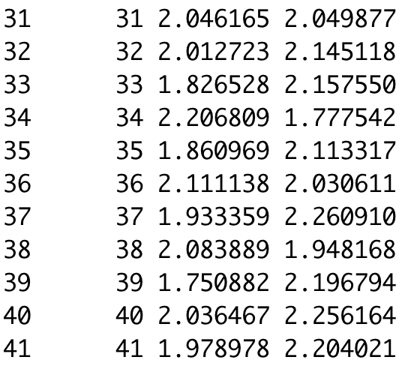
Reaction Time Experiment
A double blind study was conducted to test the effect of the drug Ritalin on the reflexes. To test for this effect, subjects were recruited via an add in the newspaper and paid $500 for their time. The subject was to come in twice and would be given a placebo in one of the visits and a dose of Ritalin in the other visit. Neither the subjects nor the researcher that gave the subject the pills new which was the Ritalin and which was the placebo (double blind). During both visits the subject wore earphones and had twitch detectors taped to the skin around their eyes. The headphones would play a soft static sound and would periodically blast a loud sound that would cause the subject to twitch. The researchers had a machine that would measure and record the time between the sound being initiated and the subjects eye twitch. For each subject the sound was initiated 10 times and the average reaction time was recorded.
The data file twitch.csv contains the average reaction time while on the placebo and Ritalin treatments.
Your goal is to conduct the appropriate 6 – step test to see if there is evidence that Ritalin causes slower reaction time.
Hint for this problem: Be mindful of your choice of test!
Be sure to include a confidence interval and mention if it agrees with the hypothesis test.

Slide 10
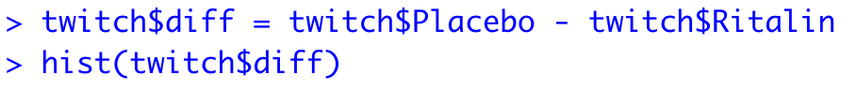
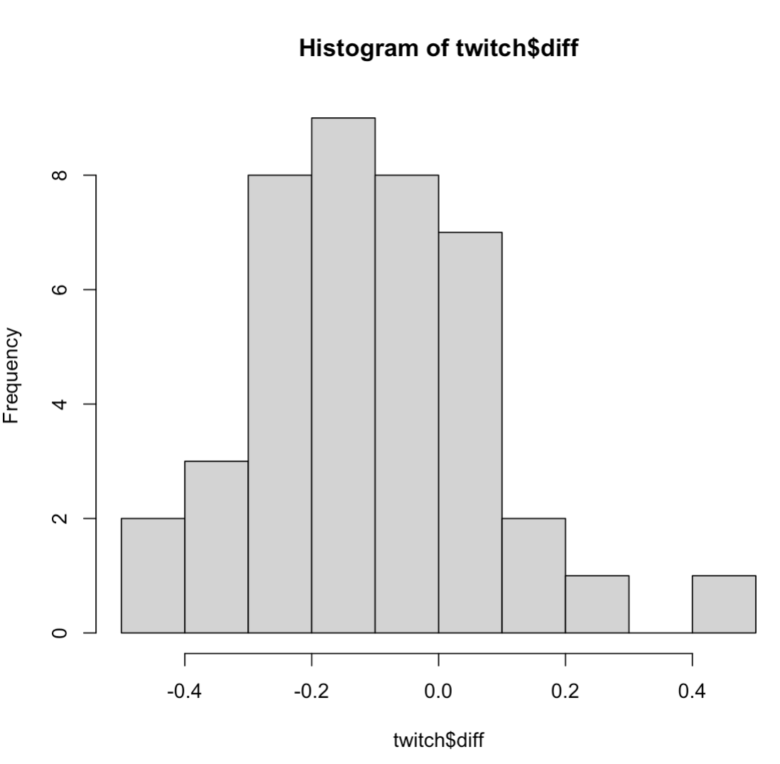
Reaction Time Experiment: Solution
The 41 differences do not look to deviate significantly from a normal distribution and the size of the sample provides confidence that the central limit theorem will insure that the sampling distribution of the sample mean difference will be normally distributed. We will assume that the subjects are independent of one another and proceed with the paired t –test.

Slide 11
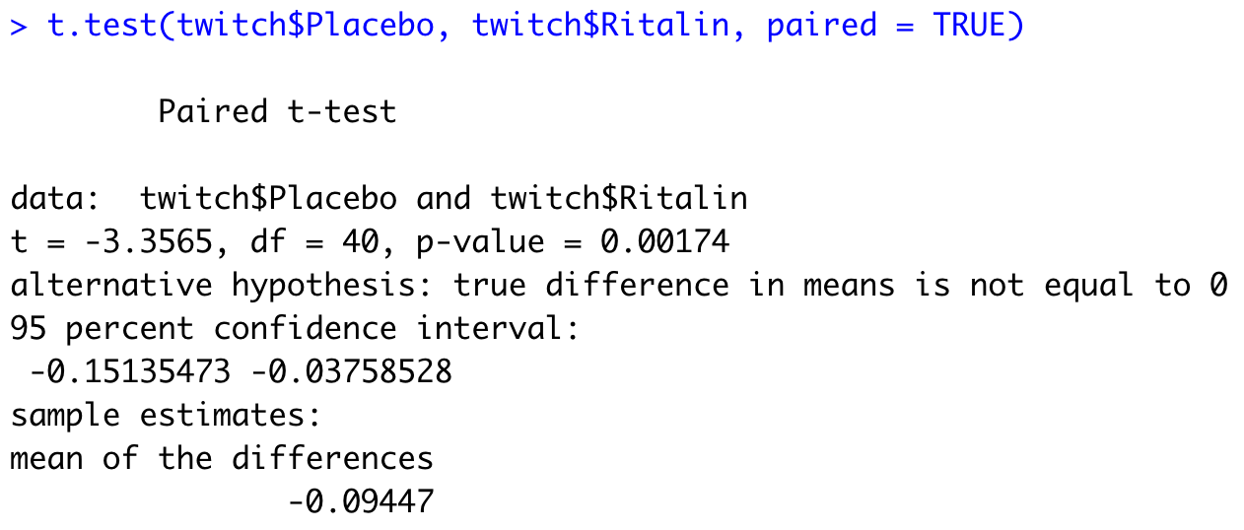
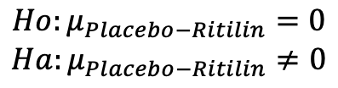
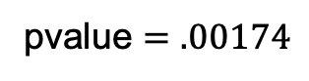
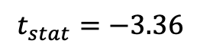
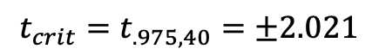
Reaction Time Experiment: Solution
$$Ho:μ_{Placebo−Ritilin}=0$$
$$Ha:μ_{Placebo−Ritilin}≠0$$
$$t_{stat}=−3.36$$
pvalue $=.00174$
$$t_{crit}=t_{.975,40}=±2.021$$
Reject Ho
There is sufficient evidence to suggest that Ritalin causes an increase in the reaction time of subjects in this study (pvalue = .00174.). A 95% confidence interval for the mean difference between the placebo and the Ritalin groups is (-.151, -.038). This means that on average reaction time is between .038 and .151 units longer after taking the Ritilin as compared to the placebo.

Slide 12
End Question 2

Slide 13

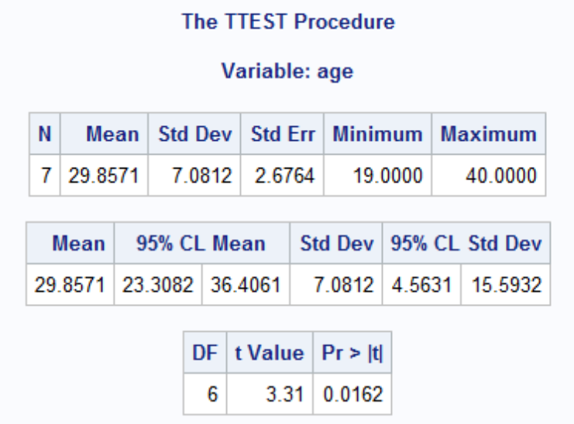
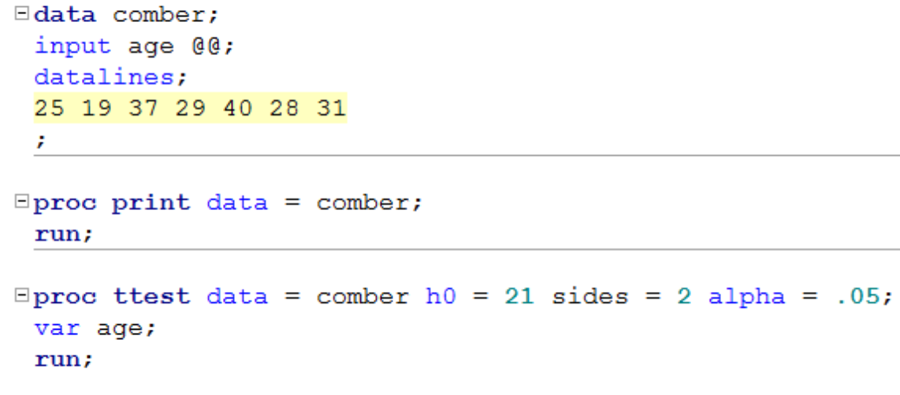
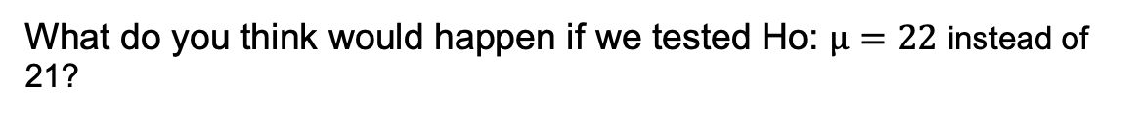
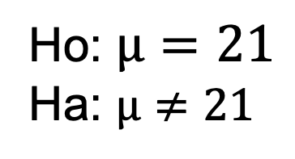
Finding the P-value
Ho: $µ=21$
Ha: $µ≠21$
Step 4: Find the p-value: P-value < .05
You could use Stat Trek / or the t-table.
OR
Software like SAS:
What do you think would happen if we tested Ho: $µ=22$ instead of 21?

Slide 14
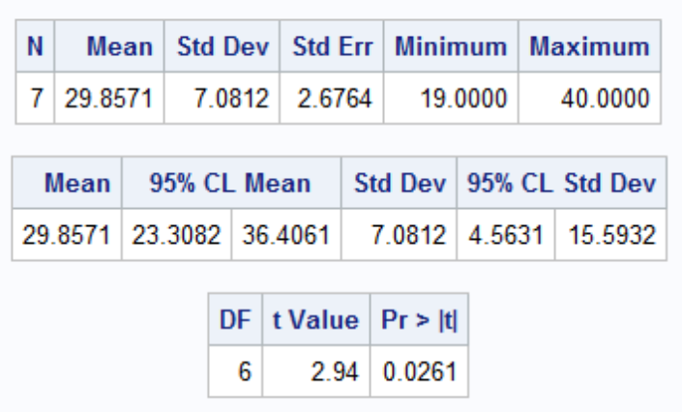
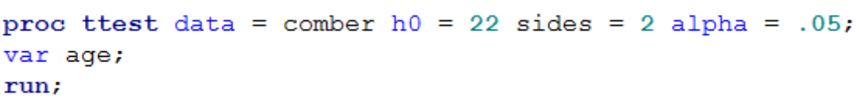

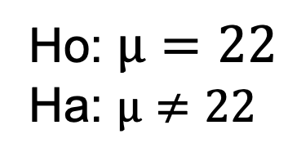
Finding the P-value
Ho: $µ=22$
Ha: $µ≠22$
Step 4: Find the p-value: P-value < .05
You could use Stat Trek / or the t-table.
OR
Software like SAS:
What do you think would happen if we tested Ho: $µ=37$?

Slide 15
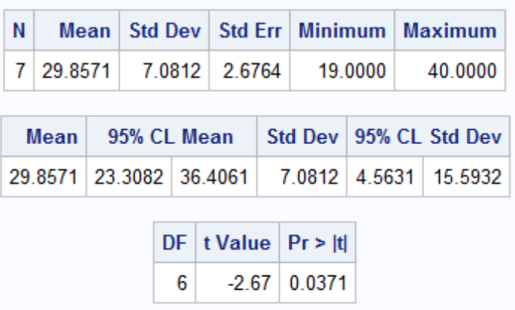
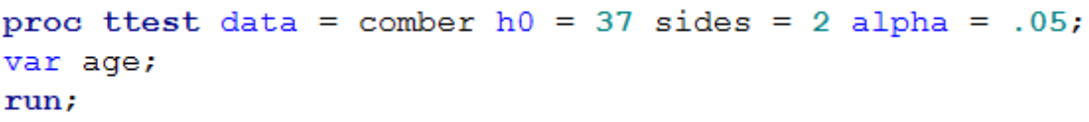

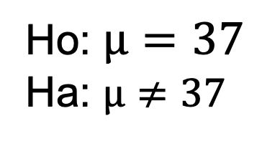
Finding the P-value
Ho: $µ=37$
Ha: $µ≠37$
Step 4: Find the p-value: P-value < .05
You could use Stat Trek / or the t-table.
OR
Software like SAS:
What do you think would happen if we tested Ho: $µ=31$?

Slide 16
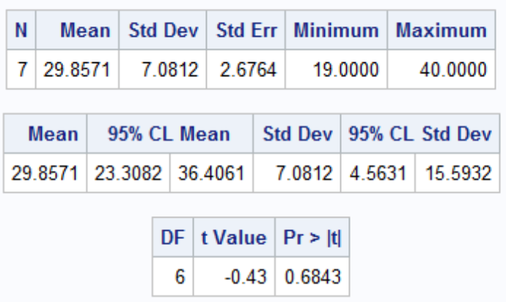
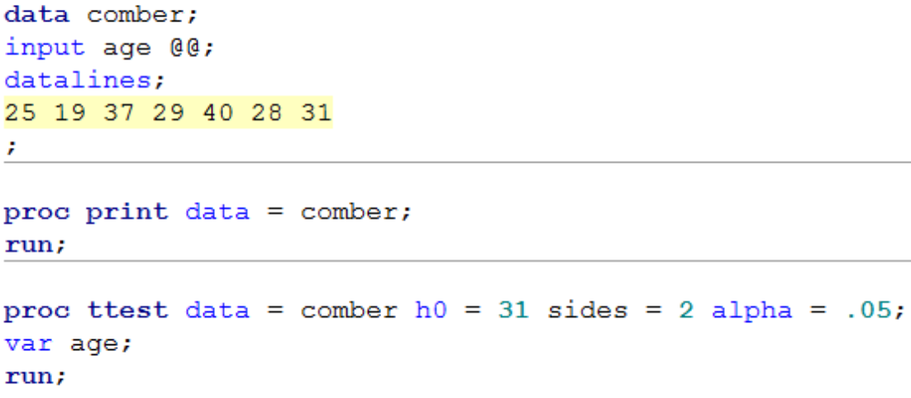

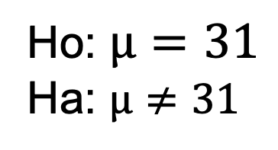
Finding the P-value
Ho: $µ=31$
Ha: $µ≠31$
Step 4: Find the p-value: P-value < .05
You could use Stat Trek / or the t-table.
OR
Software like SAS:
What do you think would happen if we tested Ho: $µ=23.2$?

Slide 17
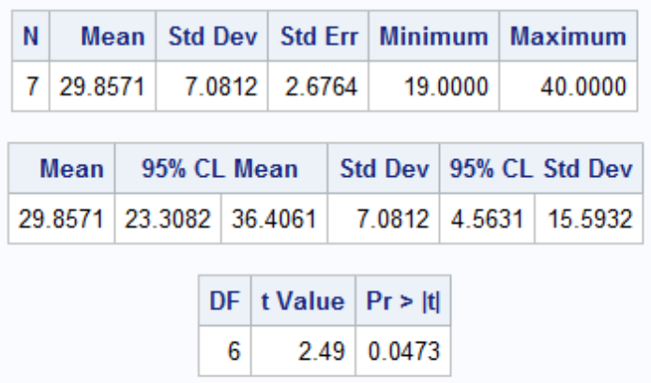
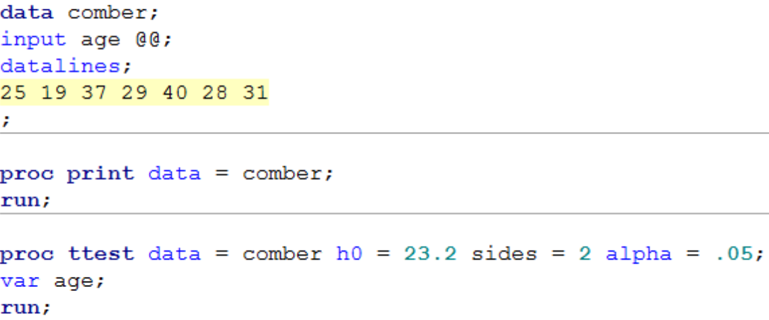
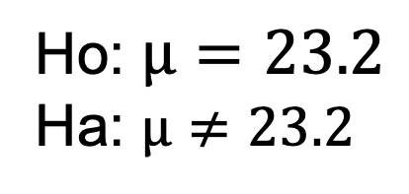
Finding the P-value
Ho: $µ=23.2$
Ha: $µ≠23.2$
Step 4: Find the p-value: P-value < .05
You could use Stat Trek / or the t-table.
OR
Software like SAS:

Slide 18
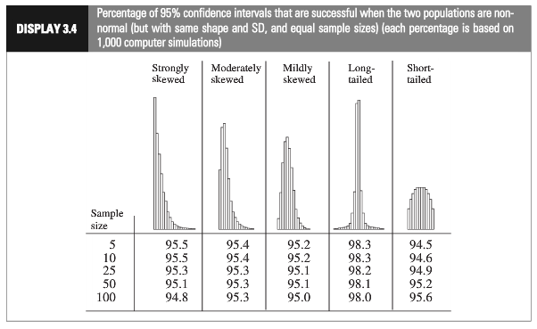
Assumptions: When data is not normal

Slide 19
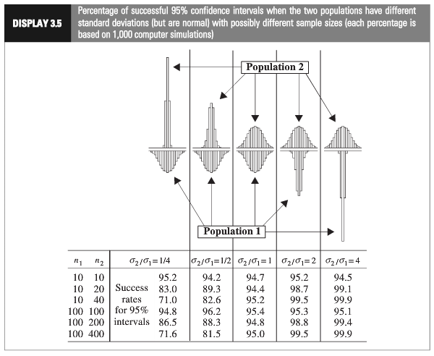
Assumptions: When variances are not equal

Slide 20
The Take Away
What you will find in practice will most likely not fit exactly into the scenarios identified here. There will be some judgment involved … this is the “art” of statistics.
Here are some general rules of thumb that we will assume this semester.
If sample sizes are the same and sufficiently large, the t tools (tests and confidence intervals) are valid … since they are robust to the violation of normality.
If the two populations have the same standard deviation, then the t tests are valid … given sufficient sample sizes.
If the standard deviations are different and the sample sizes are different then the t tools are not valid and another procedure should be used. (Ch. 4)

Slide 21
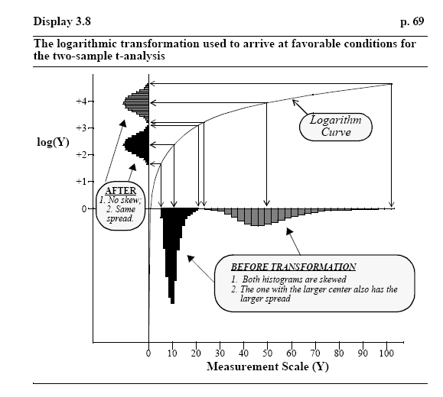
Log Transformation

Slide 22

Question 3 ($≤2$ hours)

Slide 23
Education and Income…
Find the “Education Data” data in the course materials. This data set includes annual incomes in 2005 of the subset of National Longitudinal Survey of youth (NLSY79) subjects who had paying jobs in 2005 and who had completed either 12 or 16 years of education by the time of their interview in 2006. All the subjects in this sample were between 41 and 49 years of age in 2006. Test the claim that the distribution of incomes for those with 16 years of education exceeds the distribution for those with 12 years of education. (Hint: pay careful attention to the ratio between the largest and smallest incomes in each group … also …. is the bigger mean associated with the bigger standard deviation? … Transformation?) You may use SAS or R for this problem but be sure and include your code!
Note: There is some SAS code in the course materials to help you download the data into SAS. It is a very large dataset… “datalines” is not a good idea here! You could also use the File/Import option. While you may choose which software to use, make sure you know how to use both!
Finally, make sure you present your findings as you would to a client:
State the Problem.
Address the Assumptions (graphically and using words).
Perform the Most Appropriate (Powerful) Test. (In reality, this may be a pooled t-test on the original data, a t-test on the log transformed data, or a permutation test on the original data, since these are the ones we have studied so far. For now, assume you must choose between the pooled t-test on the original data or on the log transformed data.)
Provide a conclusion including a p-value and a confidence interval.
Provide a scope of inference.

Slide 24

State the Problem
Test the claim that the distribution of incomes for those with 16 years of education exceeds the distribution for those with 12 years of education.

Slide 25
Address the Assumptions (graphically and verbally).
EducInc %>% filter(Educ == 12 | Educ == 16) %>%
ggplot(aes(x = Income2005, after_stat(density), color = FEduc, fill = FEduc)) +
geom_freqpoly() +
ggtitle("Density Plot of Income Distribution between 12 and 16 Years of Education")
The distribution of the income from both the high school (12) and college (16) groups appear to be right skewed. In addition, the distribution of incomes from the 16s group appears to have greater spread (greater standard deviation) than the incomes from the high school group.
We will perform a log transformation on the data in order to mitigate both of these violations …

Slide 26
Address the Assumptions (graphically and verbally).
EducInc$lIncome = log(EducInc$Income2005)
EducInc %>% filter(Educ == 12 | Educ == 16) %>%
ggplot(aes(x = lIncome, after_stat(density), color = FEduc, fill = FEduc)) +
geom_freqpoly() +
ggtitle("Density Plot of Income Distribution between 12 and 16 Years of Education")
The distribution of the log income from both the high school (12) and college (16) groups appear to be much more normally distributed (although now a bit left skewed.) In addition, the the distributions appear to have much more similar spreads (standard deviations). Since we have enough sample size in each group we can lean on the CLT to ensure the distribution of the difference of sample means will be normally distributed. To continue, we will assume equal standard deviations and proceed with the pooled two sampe t-test for the difference of means.
Finally, we will assume these observations are independent.

Slide 27
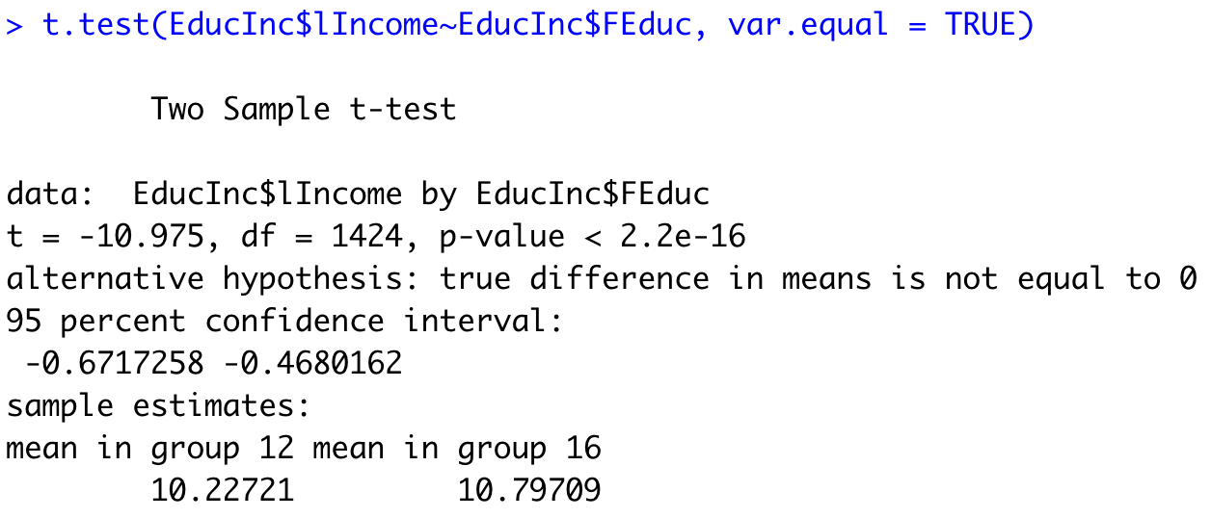
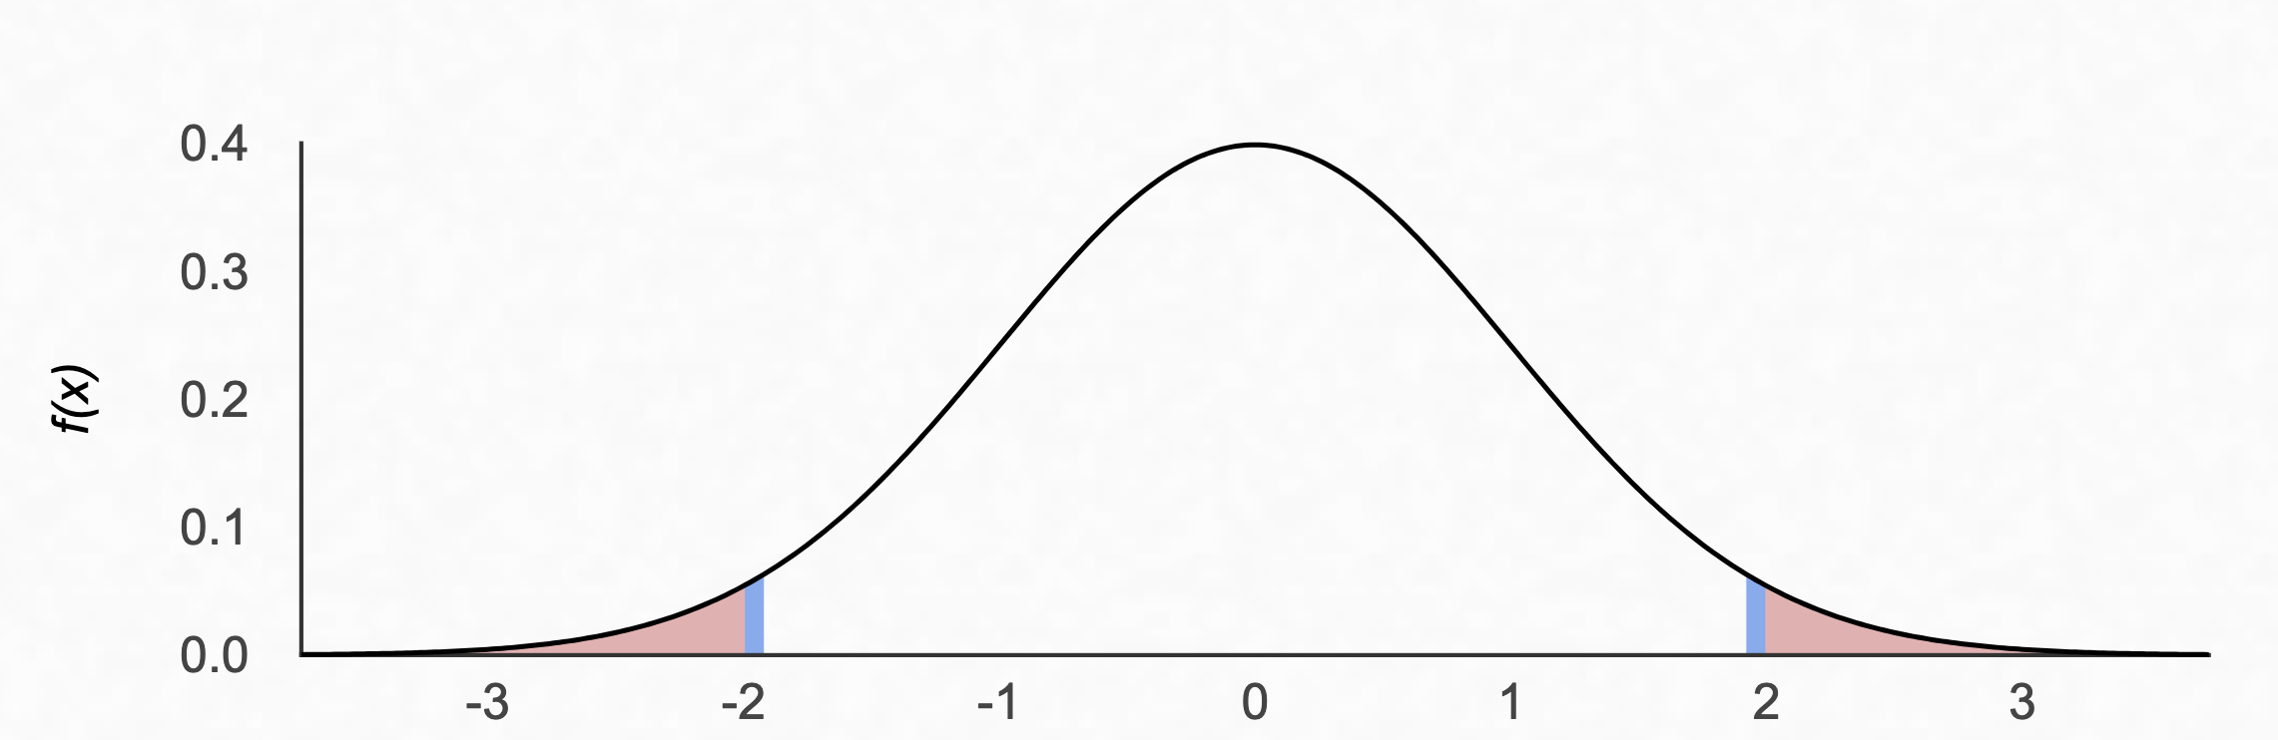
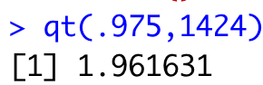
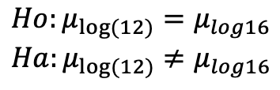
6 Step Test: Two Sided
$$Ho:μ_{log⁡(12)}=μ_{log16}$$
$$Ha:μ_{log⁡(12)}≠μ_{log16}$$
Note: the null hypothesis could also be less than or equal to.
Step 2 - Identification of Critical Value: 1.96 df = 1426-2 = 1424
Step 3 - Value of Test Statistic: t=-10.98
Step 4 - Give p-value: p<0.0001
Step 5 - Decision: Reject Ho
Step 6 – Conclusion: There is overwhelming evidence at the alpha = 0.05 level of significance (p<0.0001) that the median income in 2005 for people with 16 years of education is different from that of those with 12 years of education. Our best estimate is that the median income of those with 16 years of education is e^{.56988} = 1.77 times as large as the median income for those in the study that had only 12 years of education. A 95% confidence interval for this factor is [e^{.4680}, e^{.6717}]= [1.60, 1.96]. This was an observational study, and thus we cannot confirm that the years of education caused the increase in income, only that they are associated with each other. There is little detail about the randomness of the sample, although it is doubtful that it was a random sample. We must limit the inference gained from this study to only the subjects of this sample.
Note: an alternative way to state the conclusion would be to say the median income for those with 16 years of education was 77% larger than the median income for those that had only 12 years of education, with the confidence interval being 60% to 96%.
Note: if the order of your data was different, you would have gotten that the median income for those with 12 years of education was 0.57 times the median income of those with 16 years of education. The confidence interval would have been [e^{-.6717}, e^{-.4680}] =[0.511, 0.626]. This is completely fine as long as you interpret the results properly.
Note: A Welche’s Test would have been ok here as well. What would be the difference in the two?

Slide 28
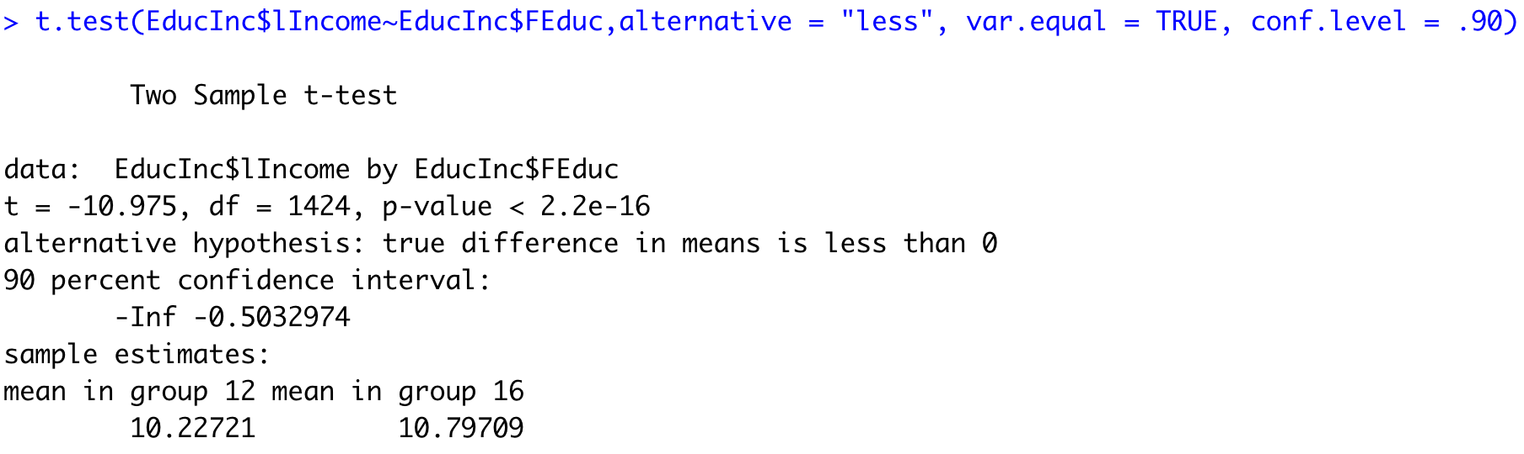
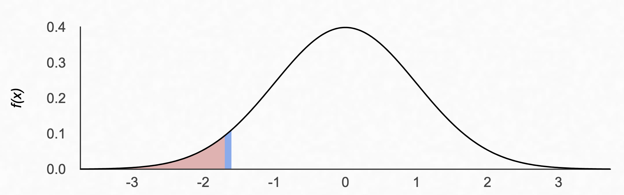
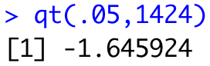
6 Step Test: 1 Sided
$$Ho:μ_{log⁡(12)}=μ_{log16}$$
$$Ha:μ_{log⁡(12)}≠μ_{log16}$$
Note: the null hypothesis could also be less than or equal to.
Step 2 - Identification of Critical Value: -1.646 df = 1426-2 = 1424
Step 3 - Value of Test Statistic: t=10.98
Step 4 - Give p-value: p<0.0001
Step 5 - Decision: Reject Ho
Step 6 – Conclusion: There is overwhelming evidence at the alpha = 0.05 level of significance (p<0.0001) that the median income in 2005 for people with 16 years of education is different from that of those with 12 years of education. Our best estimate is e^{.56988} = 1.77 times as large as the median income for those in the study that had only 12 years of education. A 90% confidence interval for this factor is [e^{.4844}, e^{.6553}]= [1.62, 1.93]. This was an observational study, and thus we cannot confirm that the years of education caused the increase in income, only that they are associated with each other. There is little detail about the randomness of the sample, although it is doubtful that it was a random sample. We must limit the inference gained from this study to only the subjects of this sample.
Note: an alternative way to state the conclusion would be to say the median income for those with 16 years of education was 77% larger than the median income for those that had only 12 years of education, with the confidence interval being 62% to 93%.
Note: if the order of your data was different, you would have gotten that the median income for those with 12 years of education was 0.57 times the median income of those with 16 years of education. The confidence interval would have been [e^{-.6553}, e^{-.4844}] =[0.519, 0.616]. This is completely fine as long as you interpret the results properly.
Note: A Welche’s Test would have been ok here as well. What would be the difference in the two?

Slide 29
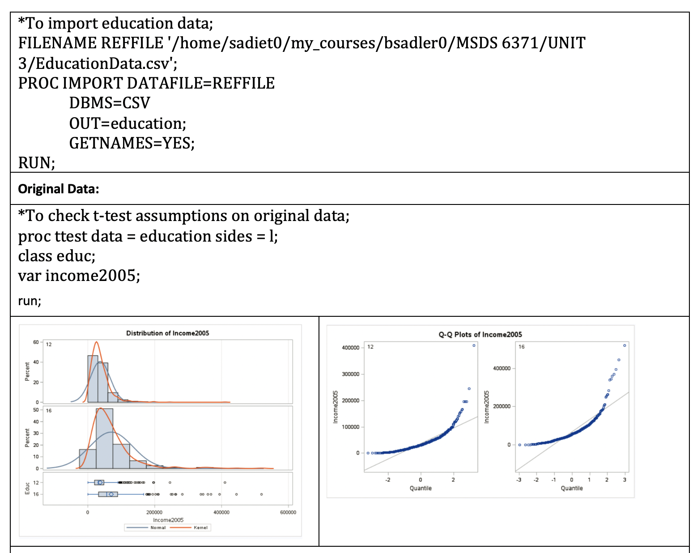
6 Step Test: 1 Sided (SAS)

Slide 30
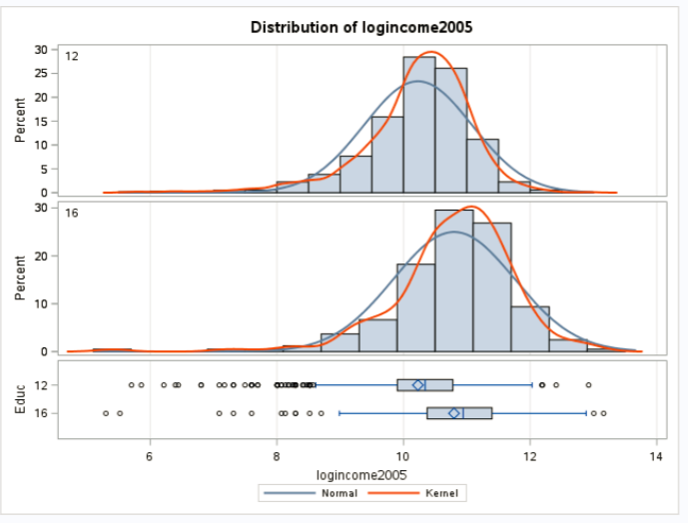
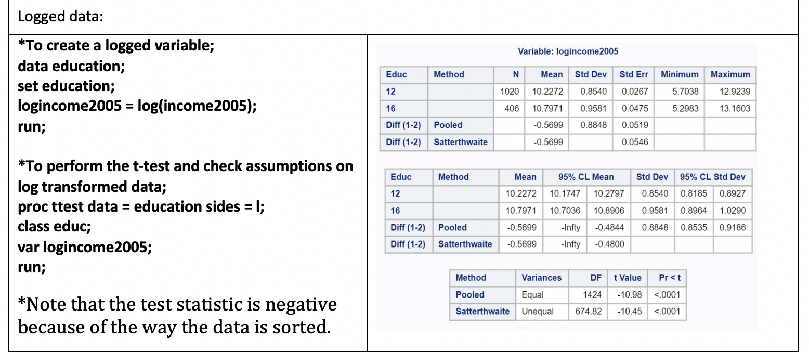
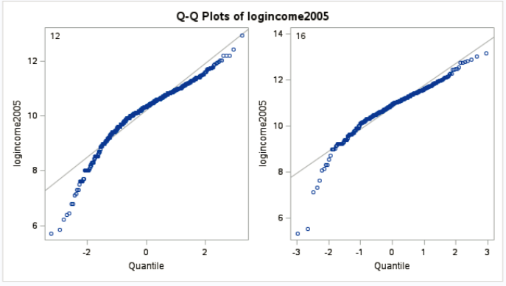
6 Step Test: 1 Sided Test With 2 Sided CI (SAS)

Slide 31
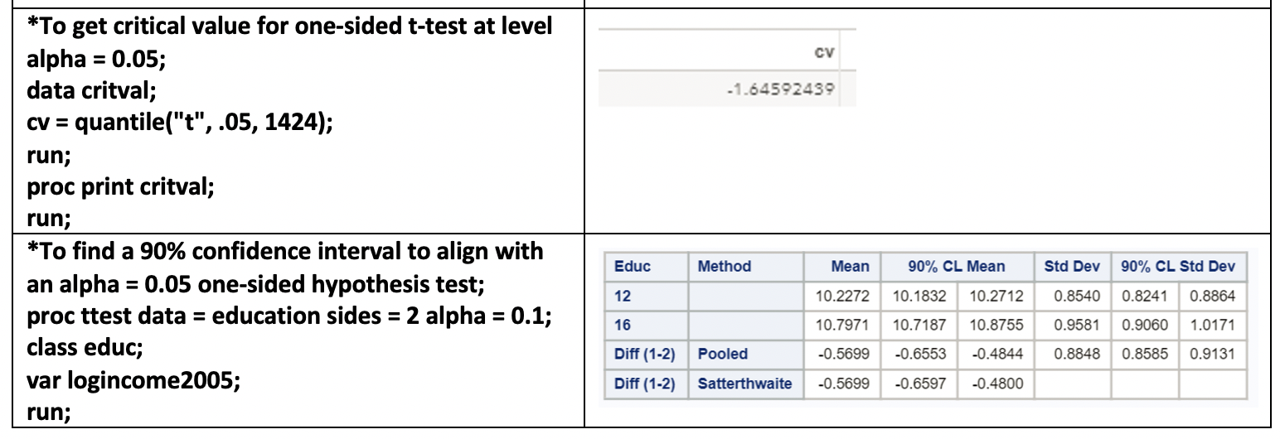
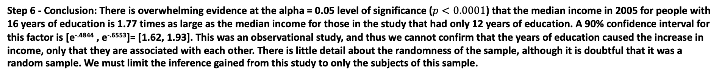
6 Step Test: 1 Sided Test With 2 Sided CI (SAS)
Step 6 - Conclusion: There is overwhelming evidence at the alpha = 0.05 level of significance ($p<0.0001$) that the median income in 2005 for people with 16 years of education is 1.77 times as large as the median income for those in the study that had only 12 years of education. A 90% confidence interval for this factor is [e^{-.4844} , e^{-.6553}]= [1.62, 1.93]. This was an observational study, and thus we cannot confirm that the years of education caused the increase in income, only that they are associated with each other. There is little detail about the randomness of the sample, although it is doubtful that it was a random sample. We must limit the inference gained from this study to only the subjects of this sample.

Slide 32
End Question 3

Slide 33
Question 4: Takeaways!
Please provide at least 4 takeaways from this section and any questions that you may have. These questions will help design the live session for this unit.
This question will be the last question of every For Live Session Assignment. The idea is that this deck will serve as a document that you can reference in the future to remember what was covered in this section. For instance, this may come in handy for the Capstone and will hopefully become useful in your career. Most immediately, it may become handy as a quick reference for your Midterm and Final! Some students find it very useful and spend a few slides summarizing the asynch material while others learn different ways and only had the minimum 4 takeaways. Either is fine and will earn you full credit for this question.

Slide 34
Question 5: Questions!
Please provide any question or topics of discussion that came up in this Unit! These will help help us optimize our live session for maximum learning and takeaways!
This question will be the last question of every For Live Session Assignment. The idea is that this deck will serve as a document that you can reference in the future to remember what was covered in this section. For instance, this may come in handy for the Capstone and will hopefully become useful in your career. Most immediately, it may become handy as a quick reference for your Midterm and Final! Some students find it very useful and spend a few slides summarizing the asynch material while others learn different ways and only had the minimum 4 takeaways. Either is fine and will earn you full credit for this question.

Slide 35
End For Live Session Assignment Unit 3!

Slide 36
Appendix

Slide 37
Appendix
Theory: Log Transformation
Example 1: Complete Analysis SSHA Test
Example 2: Complete Analysis Promotion Data

Slide 38
Theory

Slide 39
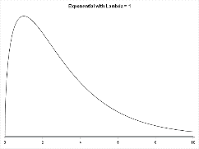

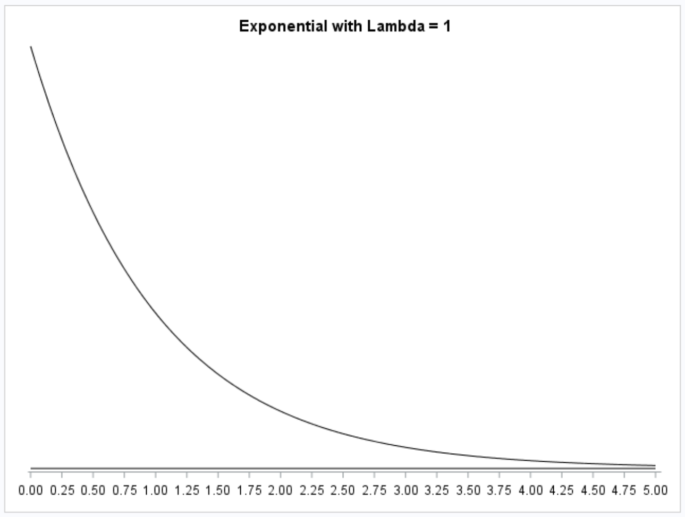
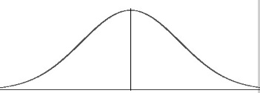
Log Transformations: Theory
Prop 1:
x
y
IF Log(x) and Log(y) are normally distributed ….
Log(x)
Log(y)
Mean[log(x)] = Median[log(x)]
Because data is now symmetric (median =mean)
Mean[log(y)] = Median[log(y)]
Prop 2:
The logarithm is a monotonically increasing function. If X1 > X2 then log(X1) > log(X2).
Therefore consider X1 through X5 in ascending order so that X1 < X2 < X3 < X4 < X5.
Then log(X1) < log(X2) < log(X3) < log(X4) < log(X5).
X | Log(X)
X1 | log(X1)
X2 | log(X2)
X3 | log(X3)
X4 | log(X4)
X5 | log(X5)
log(Median(X)) = log(X3) = Median(log(X))
log(Median(X)) = Median(log(X))

Slide 40
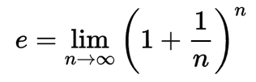
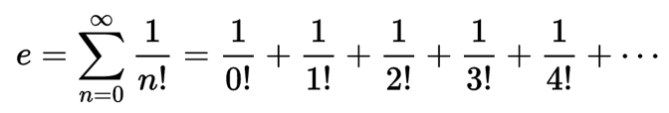








Log Transformations: Theory
Prop 3:
Prop 4a:
Prop 4b:
$$\log\left(X\right)−\log\left(Y\right)=log⁡(\frac{X}{Y})$$
$$e^{log⁡(x)}=X$$
$${10}^{\log_{10}⁡(x)}=X$$
e is a pretty remarkable number!:
Mean(log(X)) – Mean(log(Y))
Median(log(X)) – Median(log(Y))
Log(Median(X)) – Log(Median(Y))

Slide 41



Log (base e) Transformations: Theory
Prop 1:
Prop 3:
$$\log\left(X\right)−\log\left(Y\right)=log⁡(\frac{X}{Y})$$
Mean[log(x)] = Median[log(x)]
Prop 2:
Prop 4a:
log(Median(X)) = Median(log(X))
$$e^{log⁡(x)}=X$$
Derivation:
$Mean(\log\left(X\right))−⁡Mean(log\left(Y\right))=δ$ Diff of means on log scale
$Median(\log\left(X\right))−⁡Median(log\left(Y)\right)=δ$ Prop 1
$\log\left(Median\left(X\right)\right)−log⁡(Median\left(Y)\right)=δ$ Prop 2
log$\frac{Median(X)}{Median(Y)}=δ$ Prop 3
Therefore:
${e^{δ}=e}^{\text{log}\frac{Median(X)}{Median(Y)}}$=$\frac{Median(X)}{Median(Y)}$ Prop 4a
$e^{δ}$=$\frac{Median(X)}{Median(Y)}$

Slide 42


Log (base 10) Transformations: Theory
Prop 1:
Prop 3:
$$\log\left(X\right)−\log\left(Y\right)=log⁡(\frac{X}{Y})$$
Mean[log(x)] = Median[log(x)]
Prop 2:
Prop 4b:
log(Median(X) = Median(log(X))
$${10}^{\log_{10}⁡(x)}=X$$
Derivation:
$Mean(\log\left(X\right))−⁡Mean(log\left(Y\right))=δ$ Diff of means on log scale
$Median(\log\left(X\right))−⁡Median(log\left(Y)\right)=δ$ Prop 1
$\log\left(Median\left(X\right)\right)−log⁡(Median\left(Y)\right)=δ$ Prop 2
log$\frac{Median(X)}{Median(Y)}=δ$ Prop 3
Therefore:
${{10}^{δ}=10}^{\text{log}\text{10}\left[\frac{Median(X)}{Median(Y)}\right]}$=$\frac{Median(X)}{Median(Y)}$ Prop 4b
${10}^{δ}$=$\frac{Median(X)}{Median(Y)}$

Slide 43
FULL EXAMPLE: SSHA Data
The Survey of Study Habits and Attitudes (SSHA) is a psychological test designed to measure the motivation, study habits, and attitudes toward learning of college students. These factors, along with ability, are important to explain success in school. Scores on the SSHA range from 0 to 200. A selective private college gives the SSGA to an SRS of both male and female first-year students.
The data for the women are as follows:
156 109 137 115 152 140 154 178 111 123 126 126 137 165 129 200 150 140 116 120 130 131 130 140 142 117 118 145 130 145
The data for men are as follows:
118 140 114 180 115 126 92 169 139 121 132 75 88 113 151 70 115 187 114 116 117 145 149 150 120 121 117 129 92 110
Most studies have found that the mean SSHA score for men is lower than the mean score in a comparable group of women. Test this claim at the alpha = .05 level of significance. (Show all 6 steps.)
H₀: μ_{w} = μ_{m}
H₁: μ_{w} > μ_{m}

Slide 44
Full Example: SSHA Data
State the Problem: We would like to test the claim that the mean SSHA score of men is less than that of women.
Check Assumptions:
1. Normally Distributed Populations

Slide 45

First Check …. q-q Plot
The q-q plots for both populations look sufficiently normal. We look at the histograms as well … but there is not sufficient evidence here to suggest that they are not normal.

Slide 46

Histograms
Keeping in mind the relative small sample size from each population, we do not observe any extreme outliers and observe a pretty strong bell shape which lends evidence to support normality of the populations.

Slide 47
Normality Assumption
Visual inspection of the histograms and q-q plots of each population is consistent with the normality of each population. We assume normality and move on to the second assumption.

Slide 48
Full Example: SSHA Data
State the Problem: We would like to test the claim that the mean SSHA score of men is less than that of women.
Check Assumptions:
Normally Distributed Populations
Equal Standard Deviations

Slide 49

Equality of Variances
A visual check was done by looking at the histograms which reveal similar shapes and support the equal variances assumption. You can assume equal variances here.
Since we are able to assume normal population distributions, we can use the F-Test to provide secondary evidence if the visual is inconclusive. Since the p-value is greater than our significance level of alpha = 0.05, we fail to reject the null hypothesis of equality (p-value = 0.1043) of variances and conclude that there is not enough evidence to suggest the variances are different.

Slide 50
Full Example: SSHA Data
State the Problem: We would like to test the claim that the mean SSHA score of men is less than that of women.
Check Assumptions:
Normally Distributed Populations
Equal Standard Deviations
Independent Observations

Slide 51
Independent Observations
The sample was indeed a SRS (simple random sample) from the population of the selective private college, therefore we assume the observations are independent of one another.

Slide 52
Full Example: SSHA Data
State the Problem: We would like to test the claim that the mean SSHA score of men is less than that of women.
Check Assumptions:
Normally Distributed Populations
Equal Standard Deviations
Independent Observations
Run the Test:
1. First 5 steps.

Slide 53

Run The Two Sample T-Test!!!
There is no reason to pair these observations and we have two samples …. Therefore we should use the two sample t-test with pooled standard deviation since we are assuming the population standard deviations are equal. We are testing here:
H₀: $μ_{W}$ = $μ_{M}$
H₁: $μ_{W}$> $μ_{M}$

Slide 54







Critical Value
$\overline{x}W$ - $\overline{x}M$
$α$ = .05 = significance level.
df = 60 – 2 = 58
$$.05$$
0
$$t_{.95,58}=1.67$$

Slide 55

Two Sample T-Test … SAS Output

Slide 56




Let’s Formalize This Test Into 6 Steps!
We would like to test the claim that the mean SSHA score of the men is less than the mean score of women$.$ To do this we take a sample of size n_{M} = 30 and n_{W} = 30 and find that $\overline{x}$_{M} = 124.2 points, $\overline{x}W$ = 137.1 and s_{M} = 27.2 s_{W}= 20.2 points.
Ho: $µW−µM$ = 0
Ha: $µW−µM$ $>$0
Step 1: Identify the null (Ho) and alternative (Ha) hypothesis.
Step 2: Draw and Shade and Find the Critical Value.
$$t=\frac{(\overline{x}W−\overline{x}M) }{sp\sqrt{\frac{1}{nI}+\frac{1}{nE}}}=2.08$$
Step 3: Find the test statistic. (The t value for the data.)
Step 4: Find the p-value: P-value = .0211
Step 5: REJECT Ho.

Slide 57
Full Example: SSHA Data
State the Problem: We would like to test the claim that the mean SSHA score of men is less than that of women.
Check Assumptions:
Normally Distributed Populations
Equal Standard Deviations
Independent Observations
Run the Test:
1. First 5 steps.
State the Scope and Conclusion.

Slide 58
Scope
Since the study is between women and men, the subjects cannot be randomly assigned to the two groups, and we have an observational study. For this reason, we cannot make any causal inference and must limit our conclusions to differences of group means.
However, the sample was an SRS and thus any results can be inferred back to the population of students at this particular private college.

Slide 59
Two Sample T-Test … SAS Output

Slide 60

Conclusion
There is sufficient evidence to support the claim at the α=.05 level of significance (p-value = .0211) that the mean SSHA score is lower for men than for women at this college. A 95% one side confidence interval for this difference is (2.5238 points, $∞$.)
Scope of Inference: Since the study is between women and men, the subjects cannot be randomly assigned to the two groups, and we have an observational study. For this reason, we cannot make any causal inference and must limit our conclusions to differences of group means.
However, the sample was an SRS, and thus any results can be inferred back to the population of students at this particular private college.

Slide 61
ANOTHER FULL EXAMPLE

Slide 62
FULL EXAMPLE: Promotion Data
The Revenue Commissioners in Ireland conducted a contest for promotion. The ages of the unsuccessful and successful applicants are given below. Some of the applicants who were unsuccessful in getting the promotion charged that the competition involved discrimination based on age. Treat the data as samples from larger populations and use a .05 significance level to test the claim that the unsuccessful applicants are from a population with a greater mean age than the mean age of successful applicants. Based on the result, does there appear to be discrimination based on age? (Show all 6 steps.) Assume all data comes from a normally distributed population.
Unsuccessful Applicants:
34 37 37 38 41 42 43 44 44 45 45 60 46 65 49 65 53 54 62 55 56 70 64
Successful Applicants
27 33 36 37 38 38 39 42 42 43 43 44 44 44 45 70 71 72 80 46 47 75 48 72 49 49 51 51 52 54
H₀: μ_{U} = μ_{S}
H₁: μ_{S} < μ_{U}

Slide 63
Full Example: Promotion Data
State the Problem: We would like to test the claim that the mean of the successful group is less than the mean of the unsuccessful group.
Check Assumptions:
1. Normally Distributed Populations

Slide 64

First Check …. q-q Plot
Successful
Unsuccessful
The q-q plot for the successful data provides some evidence of non normality, while the q-q plot for the unsuccessful data looks consistent with normally distributed data.

Slide 65

Histograms
The successful group (top) has a clear right skew to the data, while the unsuccessful group shows a possible mild right skew. This suggests that both sets of data may be from right skewed populations. We know that the t-tools are robust to non normality for these types of distributions so we proceed with the t test…. We will readdress these concerns when we talk about the standard deviation.

Slide 66
Normality Assumption
Visual Inspection of the histograms and q-q plots indicates the both data sets may be from a right skewed distribution. We know that the t-tests are robust to violations of the normality assumption when the data are from a right skewed distribution (when the sample size is sufficient), so we proceed with the t-test.

Slide 67
Full Example: Promotion Data
State the Problem: We would like to test the claim that the mean of the successful group is less than the mean of the unsuccessful group.
Check Assumptions:
Normally Distributed Populations
Equal Standard Deviations

Slide 68

Equality of Variances
A visual check was done by looking at the histograms, which reveal similar shapes and support the equal variances assumption. We will assume equal variances here.
As secondary evidence of the visual is inconclusive, given that the p-value is greater than our significance level of alpha = 0.05, we fail to reject the null hypothesis of equality of variances (p-value = 0.2286) and conclude that there is not enough evidence to suggest the variances are different.

Slide 69
Full Example: Promotion Data
State the Problem: We would like to test the claim that the mean of the successful group is less than the mean of the unsuccessful group. Check Assumptions:
Normally Distributed Populations
Equal Standard Deviations
Independent Observations

Slide 70
Independent Observations
The sample was indeed a SRS (simple random sample) from the population of the selective private college, therefore we assume the observations are independent of one another.

Slide 71
Full Example: Promotion Data
State the Problem: We would like to test the claim that the mean of the successful group is less than the mean of the unsuccessful group.
Check Assumptions:
Normally Distributed Populations
Equal Standard Deviations
Independent Observations
Run the Test:
1. First 5 steps.

Slide 72
Run The Two Sample T-Test!!!
There is no reason to pair these observations, and we have two samples. Therefore, we should use the two sample t-test with a pooled standard deviation, since we are assuming the population standard deviations are equal. We are testing here:
H₀: μ_{s} = μ_{u}
H₁: μ_{s} < μ_{u}

Slide 73

Two Sample T-Test … SAS Output
H₀: μ_{s} = μ_{u}
H₁: μ_{s} < μ_{u}
Fail to reject the null hypothesis at 0.05 level.

Slide 74
Full Example: Promotion Data
State the Problem: We would like to test the claim that the mean of the successful group is less than the mean of the unsuccessful group.
Check Assumptions:
Normally Distributed Populations
Equal Standard Deviations
Independent Observations
Run the Test:
1. First 5 steps.
State the Scope and Conclusion.

Slide 75
SCOPE
Since the study is between successful and unsuccessful candidates for a promotion, subjects cannot be randomly assigned to the two groups, and we have an observational study. For this reason we cannot make any causal inference and must limit our conclusions to differences of group means.
However, the sample was an SRS and thus any results can be inferred back to candidates for promotion from the population that the Revenue Commissioners of Ireland sampled.

Slide 76
Conclusion
There is not sufficient evidence to support the claim at the α=.05 level of significance (p-value = .4357) that the mean age of those who were given a promotion is lower than those who were not given the promotion in this . A 90% confidence interval for this difference is (-6.3 points, 5.2 points.)

